Slide 1
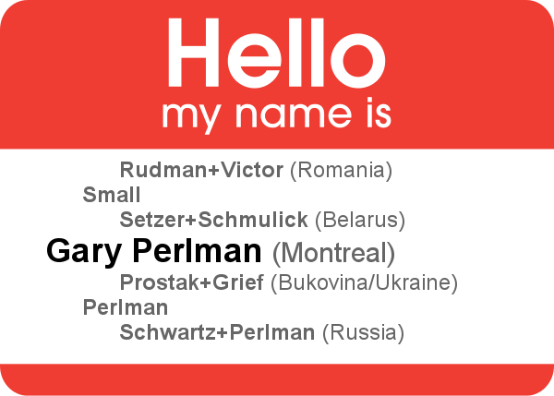
My Lucky Discoveries
Gary Perlman
Webmaven
JGS-Montreal.org
gary@perlman.ca

Slide 2
Plan for the Presentation
Lucky discoveries in my Rudman family
Lucky discoveries in my Perlman family
How to make your own luck

Slide 3
My Rudman Family
Isaac Rudman (1854-1926)
S. Malka Leibovitz (1863-1927)
Jeannette Victor (1881-1948) (my great-grandmother, 'Shlyma')
Jack Rudman (1886-1932)
William Edward Redmond (1890-1939)

Slide 4
The Search for “Teddy”
All on de la Savanne, except youngest, "Teddy"
Children were given French names in Egypt?
William Redmond in 1921 census in Montreal
Married Jessie Simon in Toronto, two children
Died in Toronto in 1939, found in JOWBR (cousin, Edward Redmond Victor, born 1940)

Slide 5
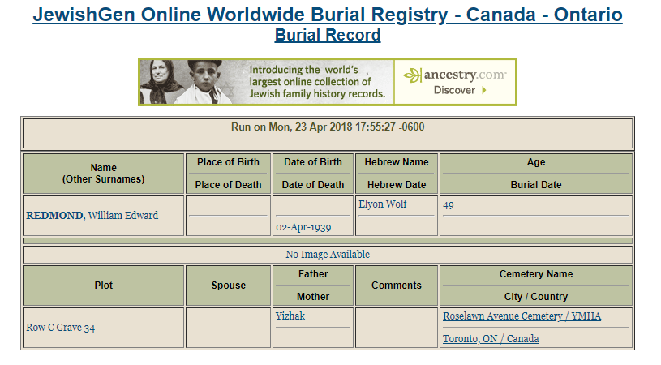
William Redmond in JOWBR

Slide 6
Searching for Redmond Family
Requested photos on FindaGrave.com
Taken by volunteer 2016-Oct-02
William Edward was a father
Jessie Simon was a grandmother!
There were pebbles! Visitors!

Slide 7
Redmonds on FindaGrave.com

Slide 8
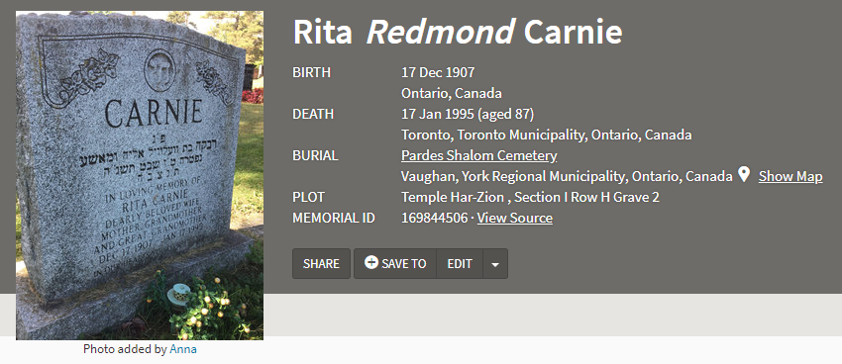
Looking for Rita Redmond Carney
Requested photo for daughter, Rita
Dolly died on her 10th birthday
Photo taken by volunteer 2017-Sep-28
Rita Redmond Carnie, great-grandmother!
How to find out more?

Slide 9
Trying to be Visible, Findable
My family tree is on Geni.com
Was on MyHeritage
Mirrored on Ancestry, FamilySearch, JewishGen FTJP
Gravestones on FindaGrave.com
Some entries have attractive portraits (i.e., attract relatives)

Slide 10
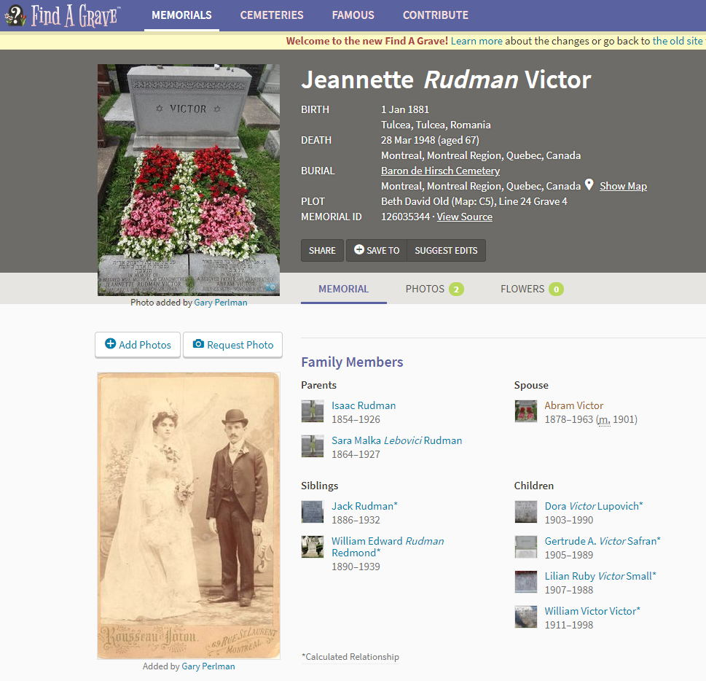
Jeannette Rudman Victor on FindaGrave.com

Slide 11
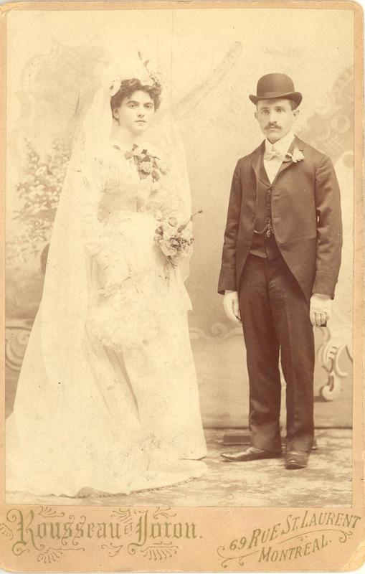
Redmond Cousin Finds Me!
Recognized a photo
Contacted me January 2018
Photo from 1901 marriage of Jeannette (my great-grandmother)

Slide 12
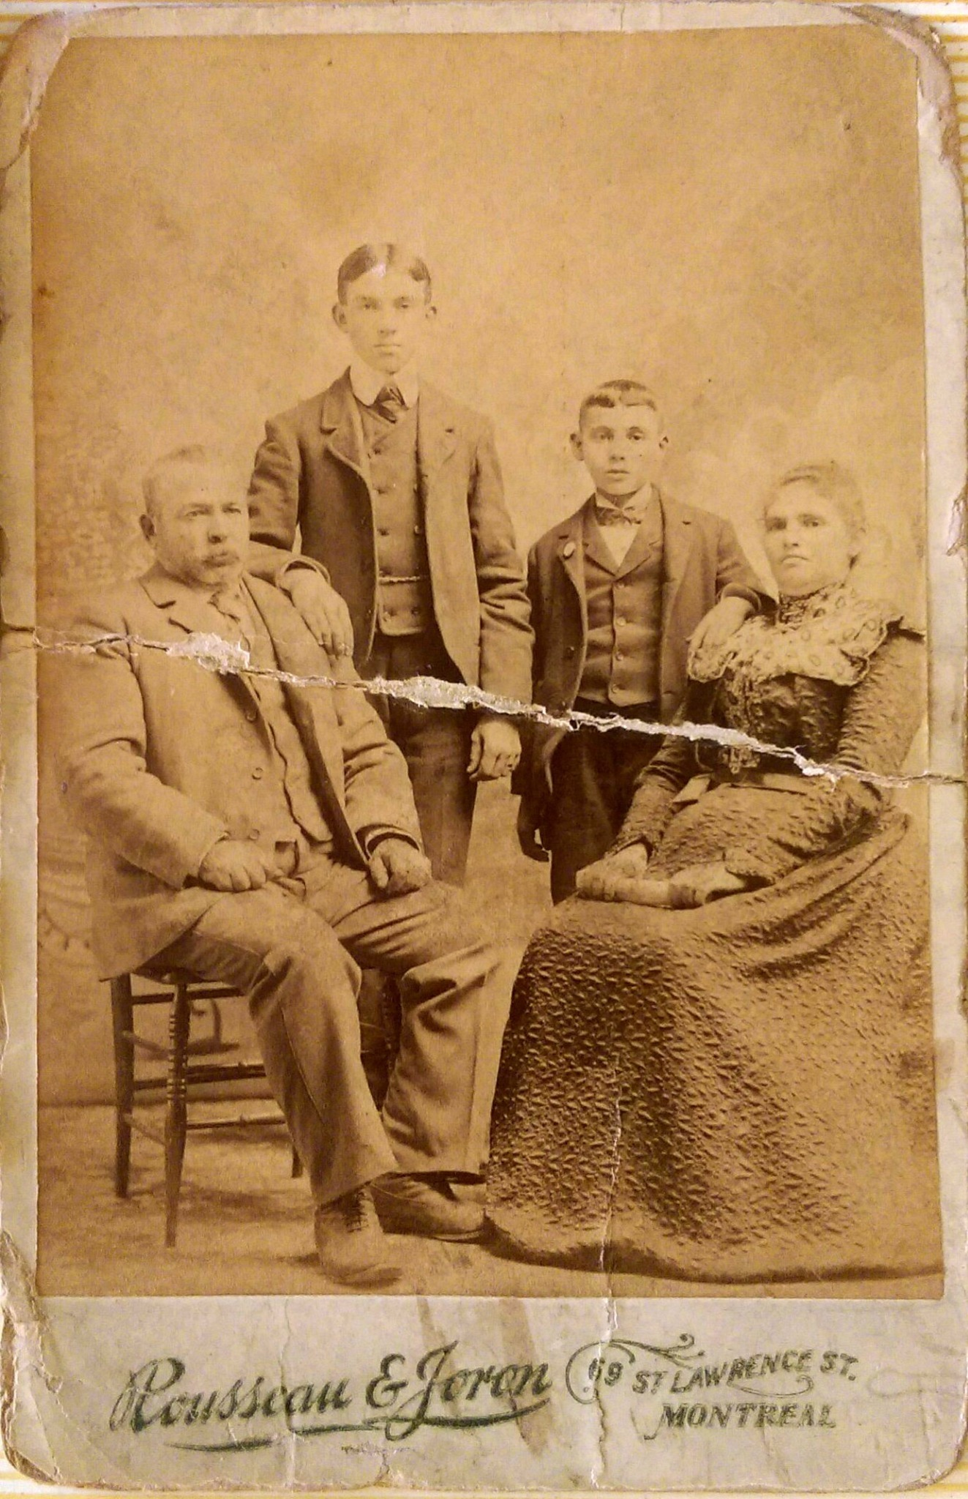
Redmond Cousin Sends Photo
Didn't know who
Same background, Same studio
Faces match portraits of Isaac and Malka
Matches Jack's and Teddy's Ears
It's my Rudman Family!

Slide 13
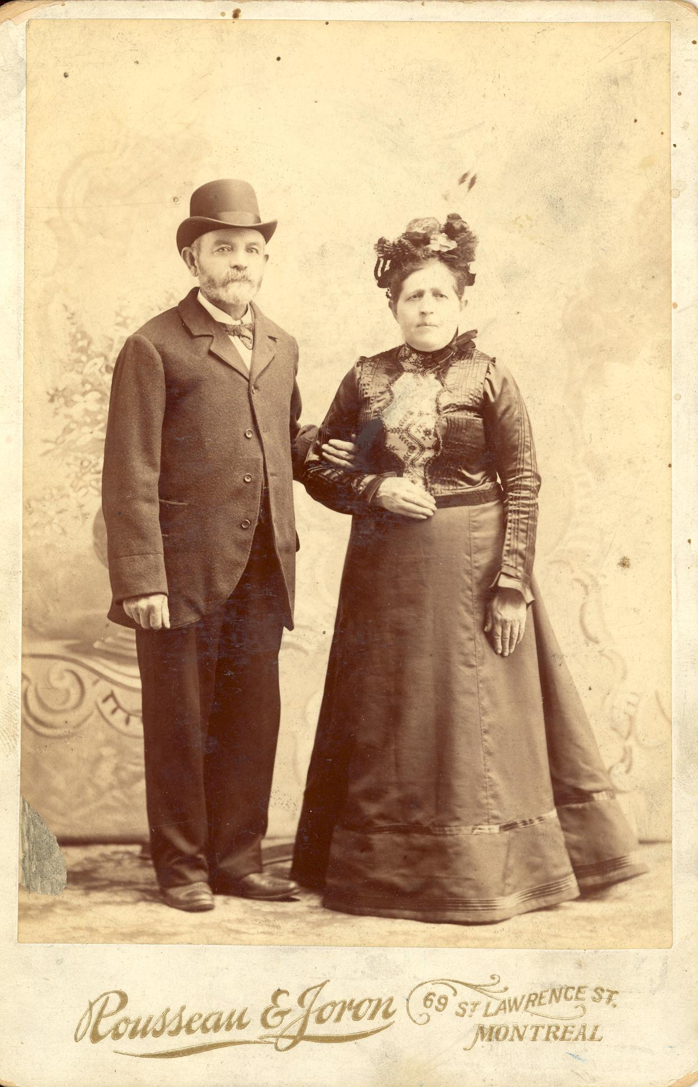
Completing the Set
Matches photo style, background
Portraits of Jeannette's In-laws:
Moses Victor (1841-1912)
Zisel Lazarovitch (1845-1917)

Slide 14
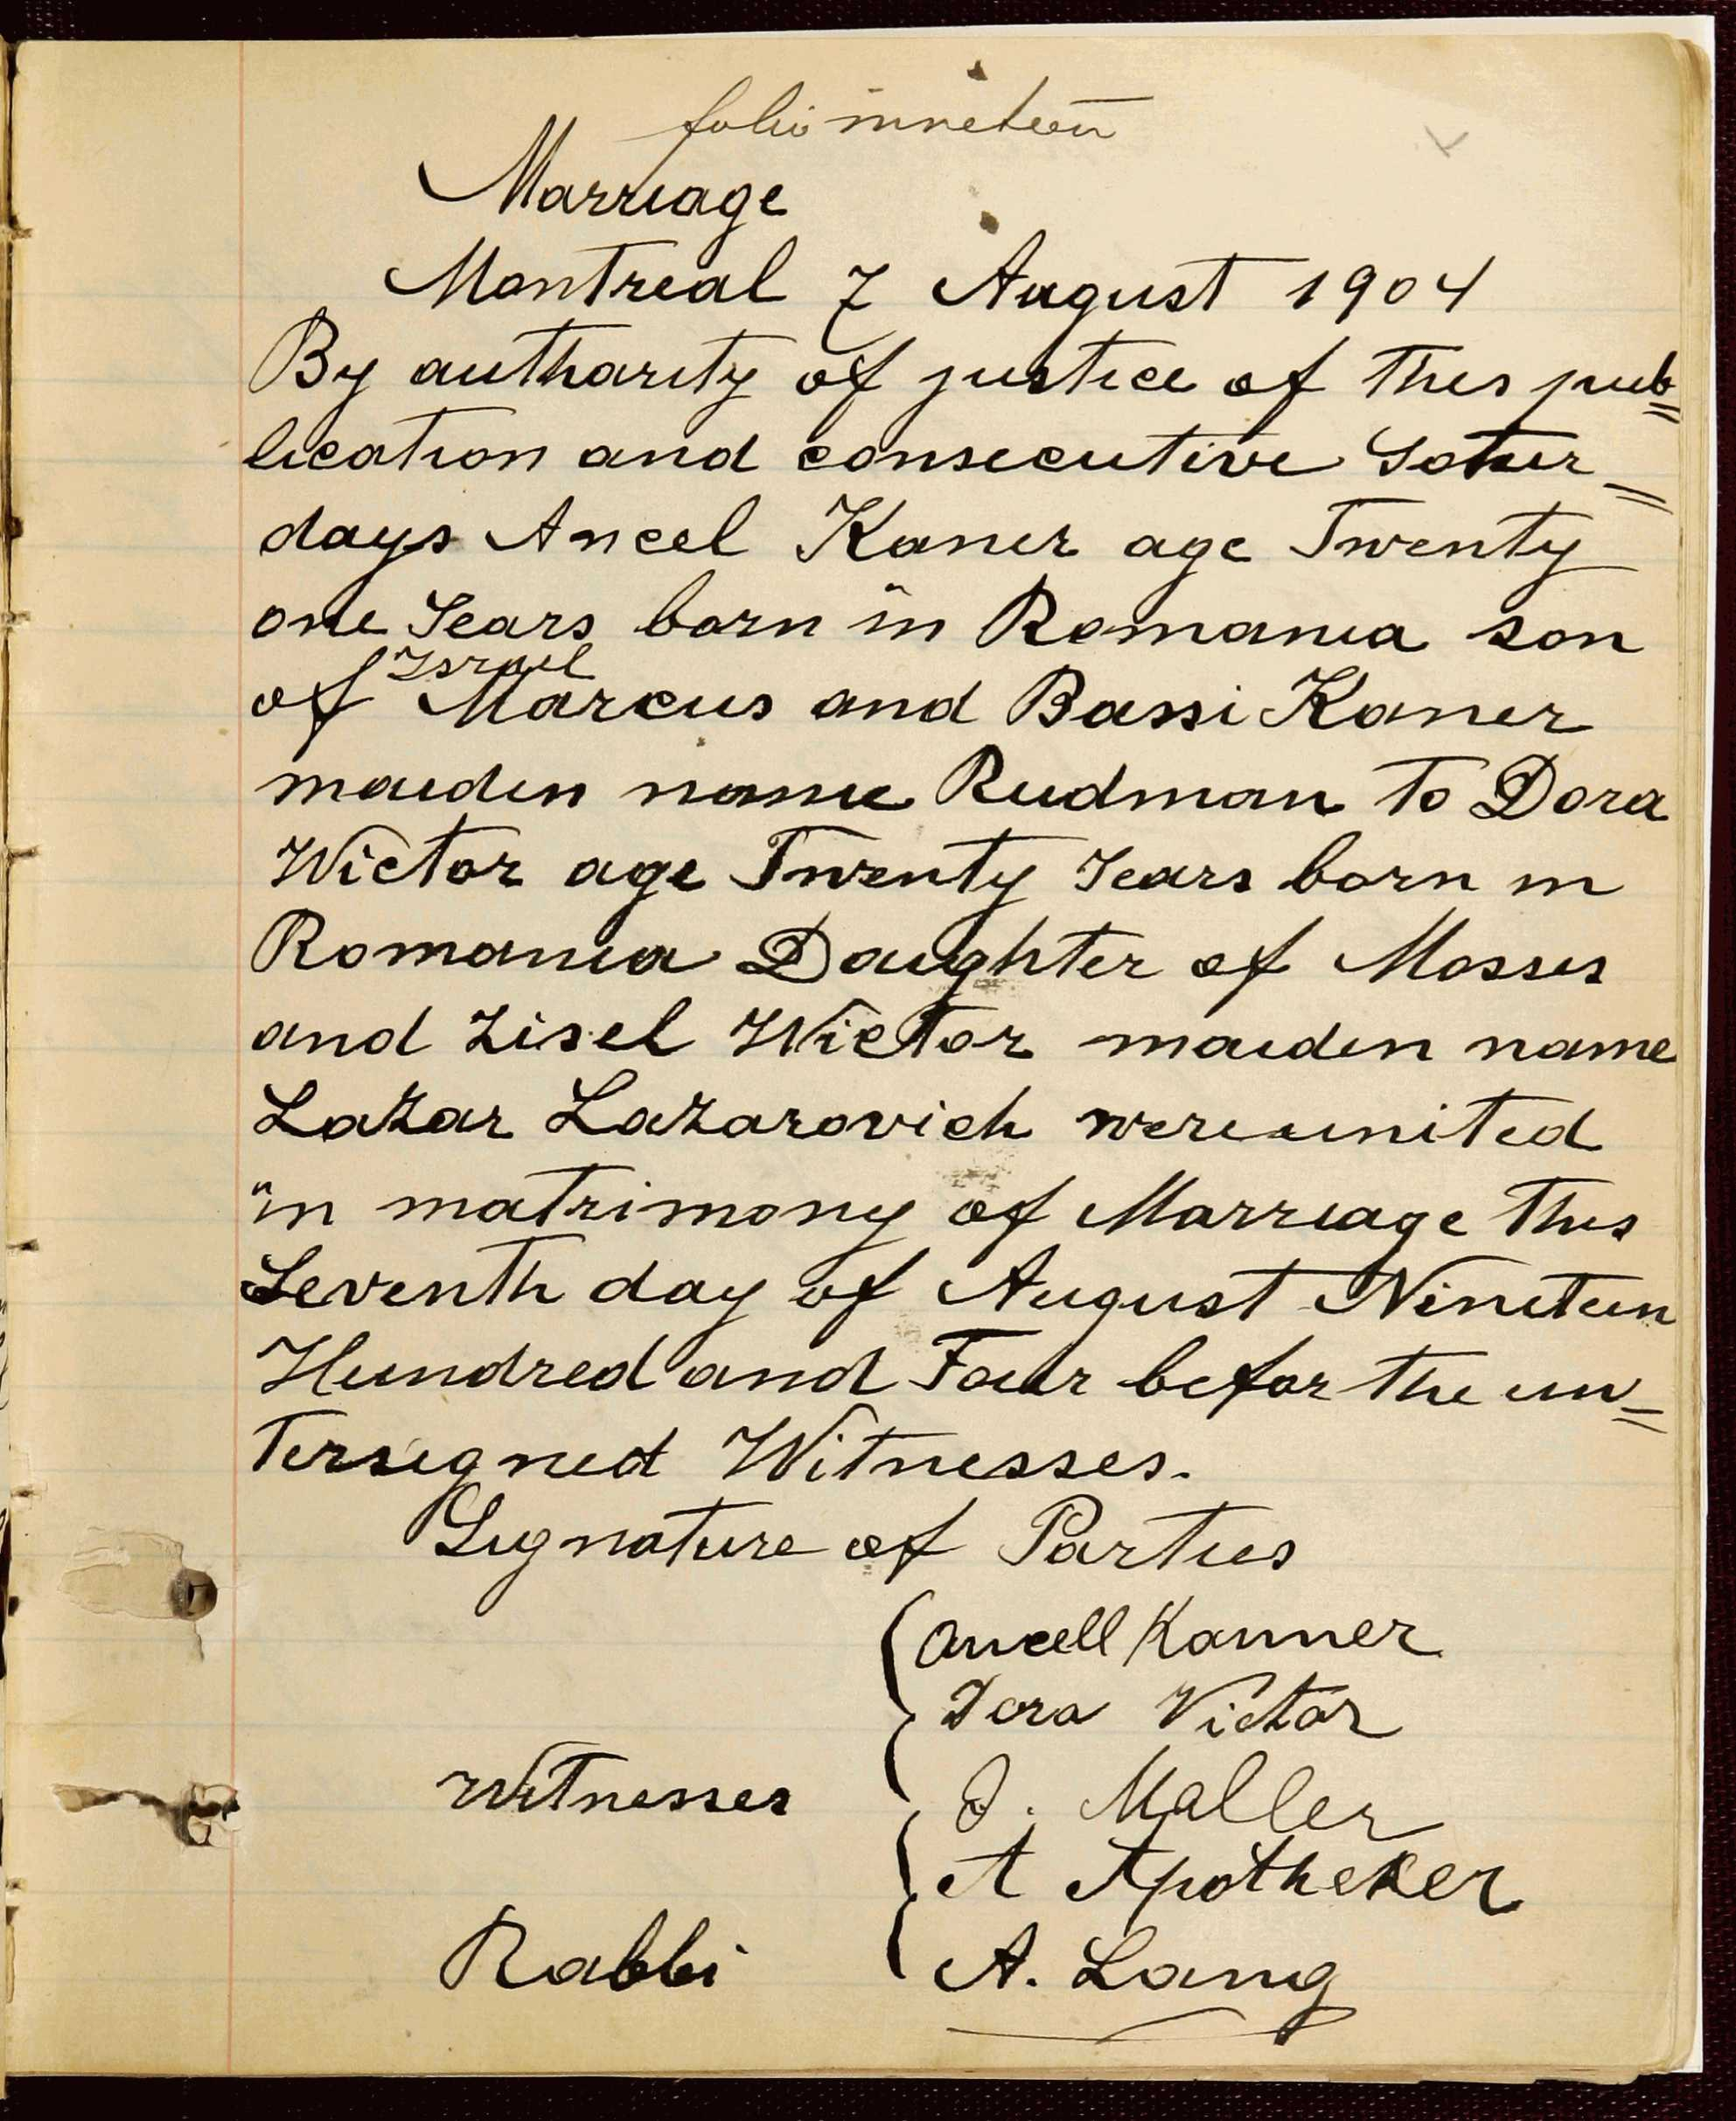
My Lazarovitch Family
Didn't read marriage record carefully (or, didn't get implications)
Zisel's father was Eliezar Lazarovitch
Beth David Old has several Lazarovitch ben Eliezar!

Slide 15
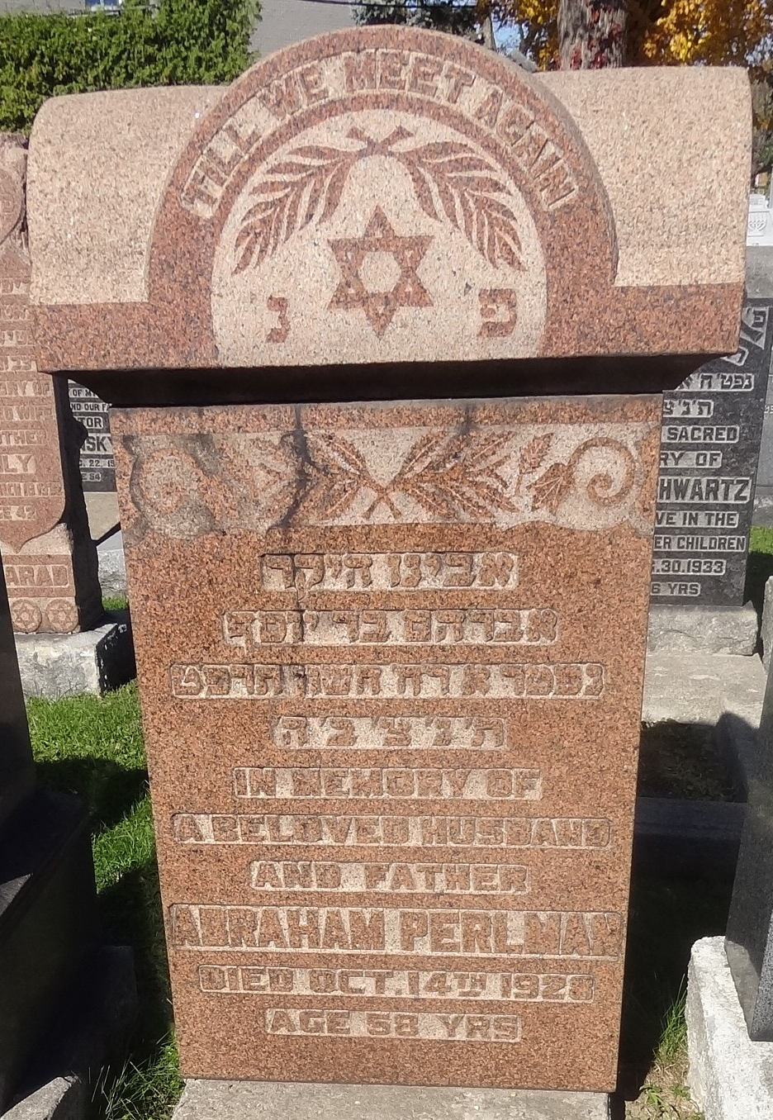
My Perlman Family
Abraham Perlman Avraham bar Yosef
From obituary: 3 brothers, N. Perlman of Montreal, Max and Lou of Vancouver
Found Nachman Perlman in Vancouver
Got Nachman's gravestone via FindaGrave.com

Slide 16
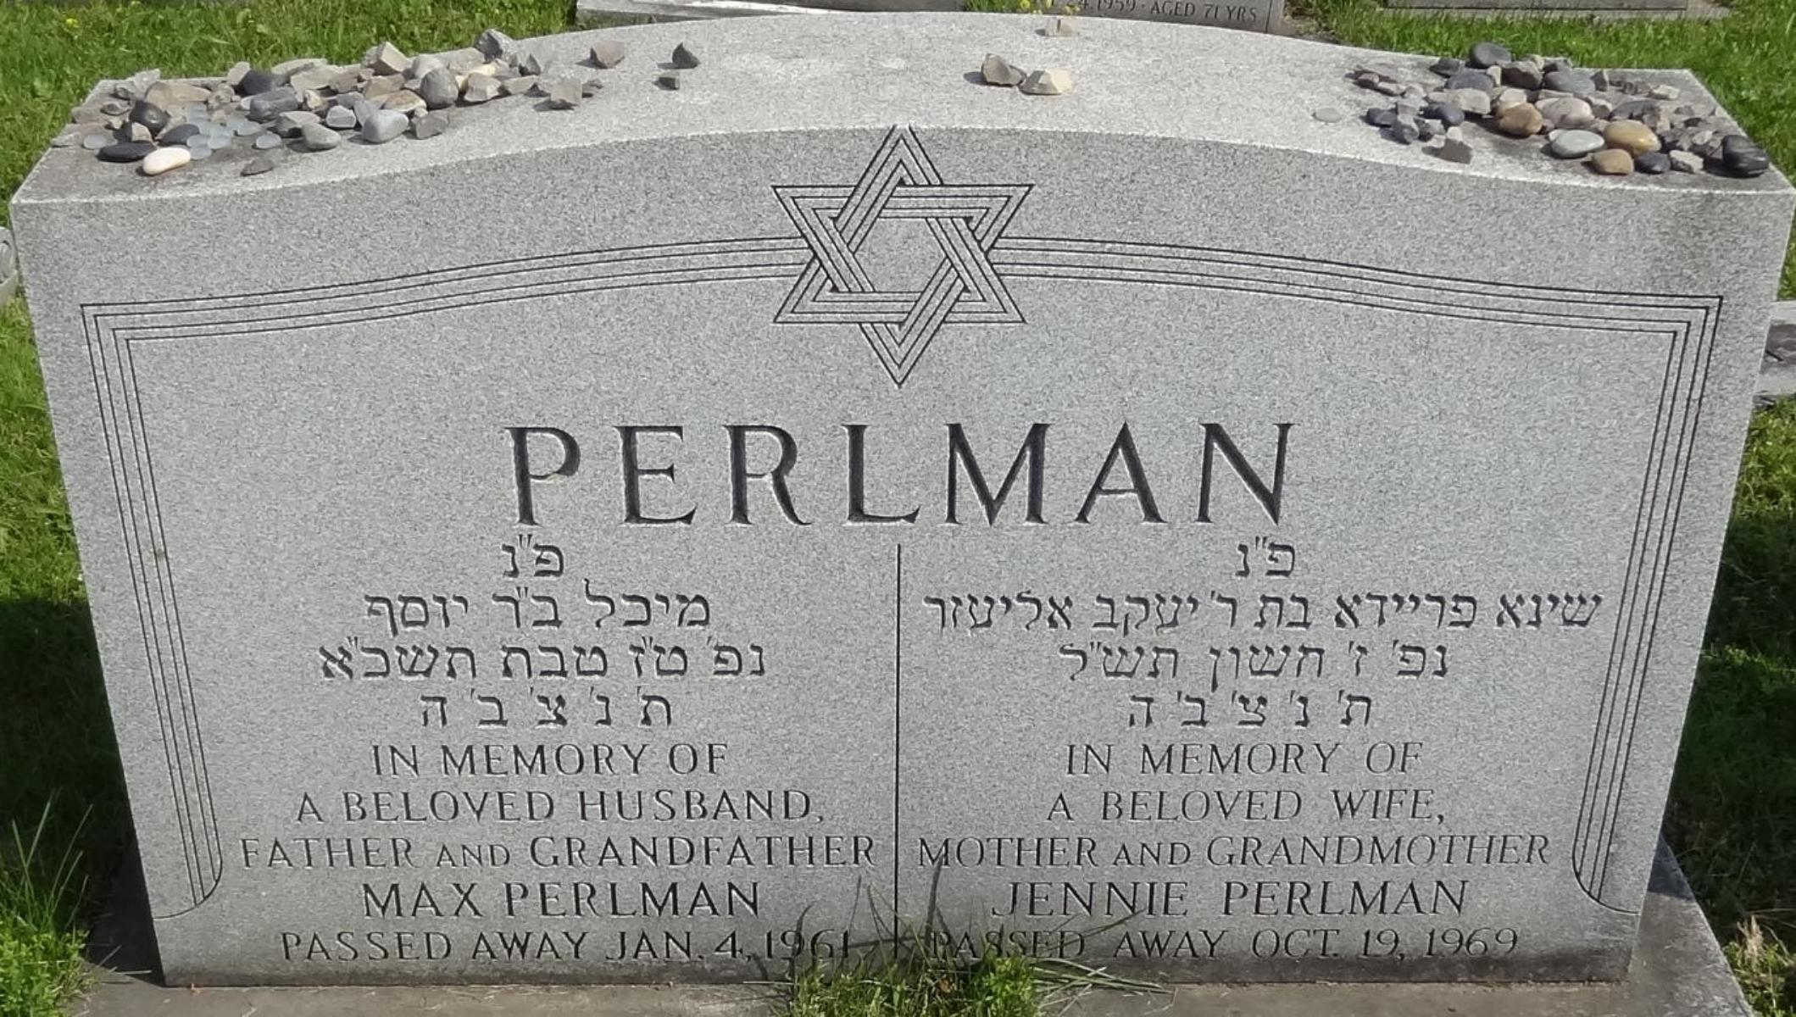
Finding Max Perlman
Had misread Abraham's gravestone for years
Had ruled out this Max (Michal bar Yosef) for years
Tracked all Perlmans on FindaGrave
Eventually established relation, helped by Vancouver cousin

Slide 17
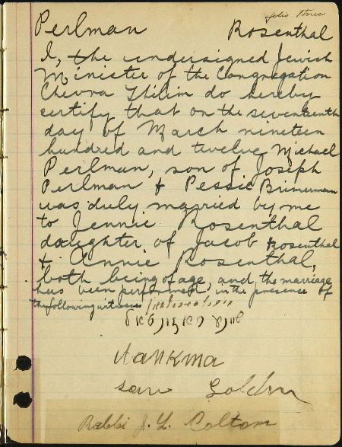
Finding Pessie Brimerman
Max Perlman married Jennie Rosenthal in Montreal in 1912
Record names Pessie Brimerman
Max and Abraham Perlman’s mother, my 2nd-great-grandmother

Slide 18
Conclusion: Make your own luck!
Keep track of everyone, even non-relatives
I like FindaGrave.com because it's outside my family tree
Track everything about family using checklists
what about Lou Perlman?
what about Lazarovitch?
what about Brimerman?
Be visible, findable, share photos
Online family trees
FindaGrave.com - photos, relations, portraits
on JOWBR?
How to add information to JOWBR?

Slide 19
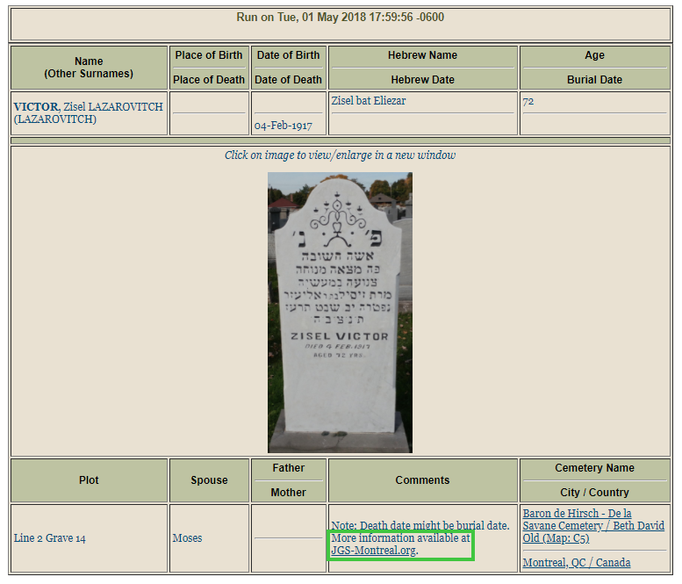
Enhancing JOWBR Records
JewishGen Online Worldwide Burial Registry
JGS-Montreal.org has submitted records for years
Added 20K+ photos
JOWBR allows one photo
Dec. 2017, submitted 10K+ records/photos
Each has: more information at JGS-Montreal.org

Slide 20
More about Zisel Lazarovitch Victor
Repetition of JOWBR data + photos
Link to a List of Burials in section
Links to trees on Geni, Ancestry
Links to FindaGrave JewishData, BillionGraves
Research Link (Genealogy Dashboard)
Button to Report issues
Future: GPS, links to relatives

Slide 21
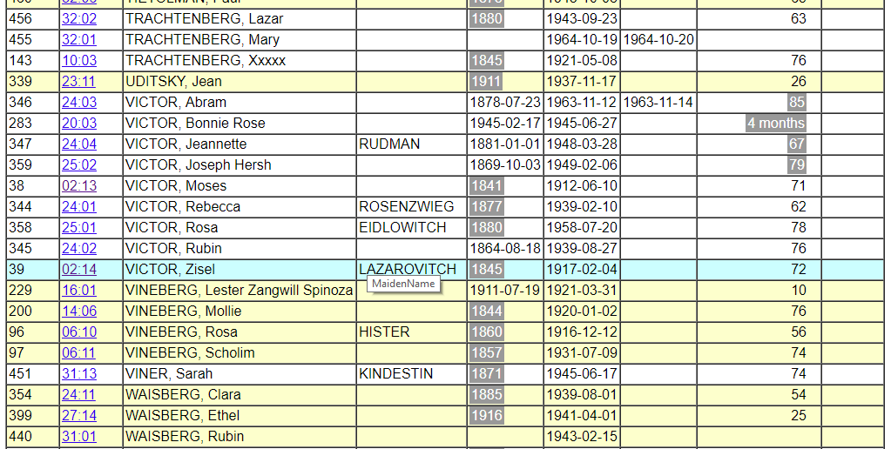
More Info: Sortable List of Burials
Sortable by Location, Name, Dates, Age
Highlighting of Groups (depends on sort)
Calculated Birth Year/Age

Slide 22
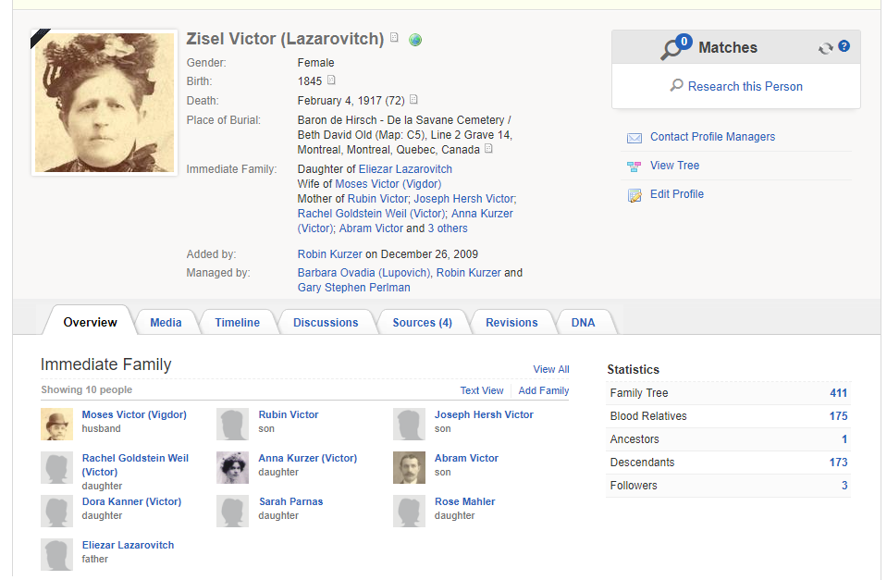
More Info: Tree on Geni.com
411 profiles, 175 relatives, 126 living

Slide 23
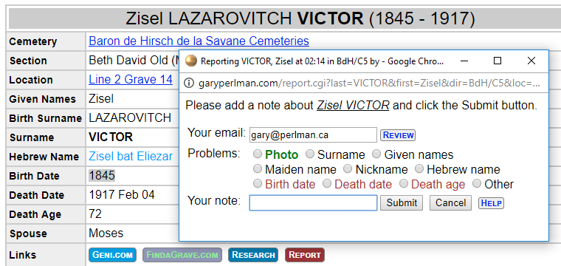
More Info: Report Issues
Used for JOWBR data validation
Saves reports for future processing

Slide 24
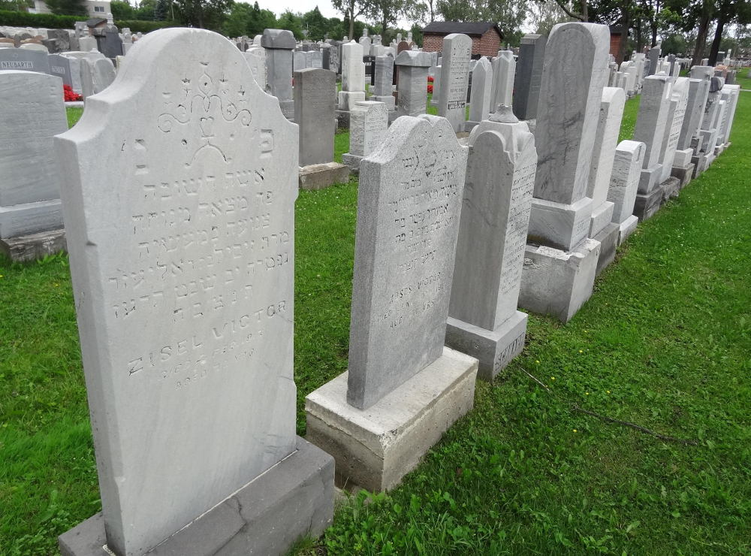
More Info: Context Photos
Beth David Old (C5) Line 2
Before "relettering"

Slide 25
Thank You! Next Please!
Volunteer for our JOWBR efforts!
Gary Perlman, gary@perlman.ca

