Slide 1
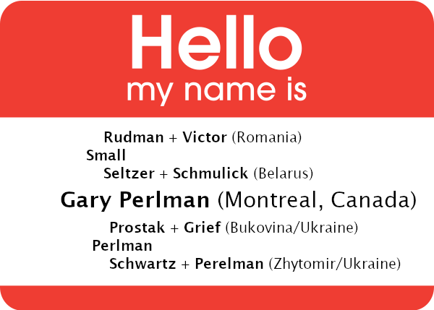
Tracing Your Roots
Gary Perlman
Webmaven
JGS-Montreal.org
gary@perlman.ca

Slide 2
Plan for the Presentation
Montreal Jewish Genealogy
Getting organized for research
Examples of research
Organizing people and documents in trees
Where to learn more
Notes:
Such as JewishGen.org

Slide 3
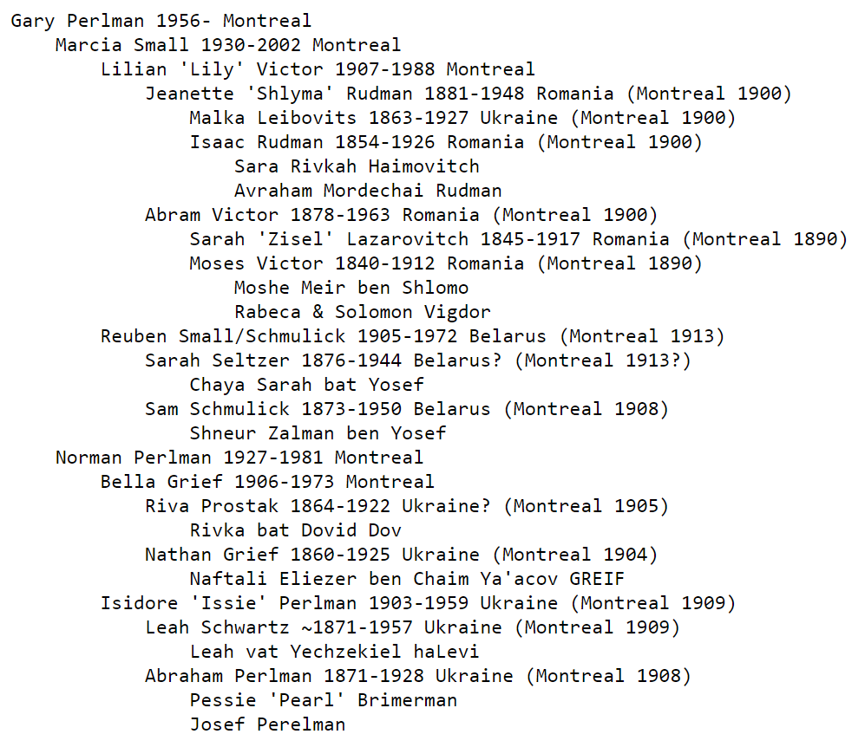
Getting Organized
Audience survey
Gather names, places, dates
Compile BMD+
Start small, think BIG
Notes:
Who is using databases/archives?
Who maintains an online family tree?
Who has taken a DNA test? (will not discuss)
Name spelling varies for many reasons, but not immigration officials
Jeannette spelled her name differently in every document (went by Shlyma)
Place names and countries change - tracking resources in JewishGen.org
- Russia = Russian empire; Austria = Austro-Hungarian empire
- Jewish calendar, Russian dates before 1918

Slide 4
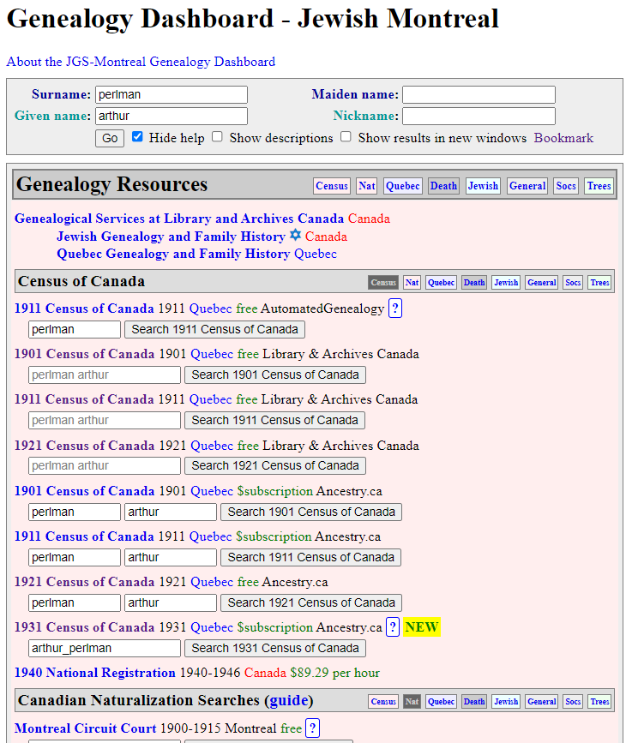
Research Examples
Anne Perlman
Start with what you know
JGS-Montreal Genealogy Dashboard
Notes:
Canada census
Canadian naturalization
Quebec and Montreal
Death and burial
Jewish
General
Societies
Online family trees
(Ancestry, Geni, MyHeritage, Family Search)

Slide 5
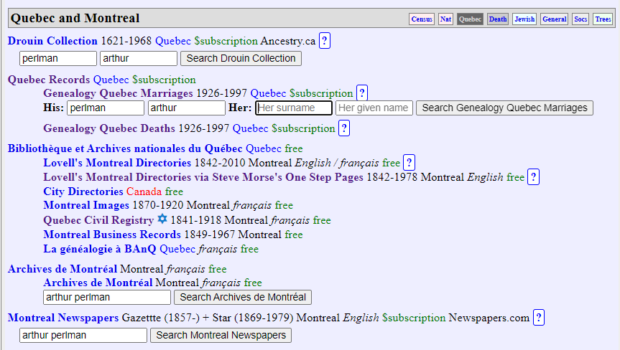
Research: Civil Marriage Record
Marriage record shows maiden name, birth, ...

Slide 6
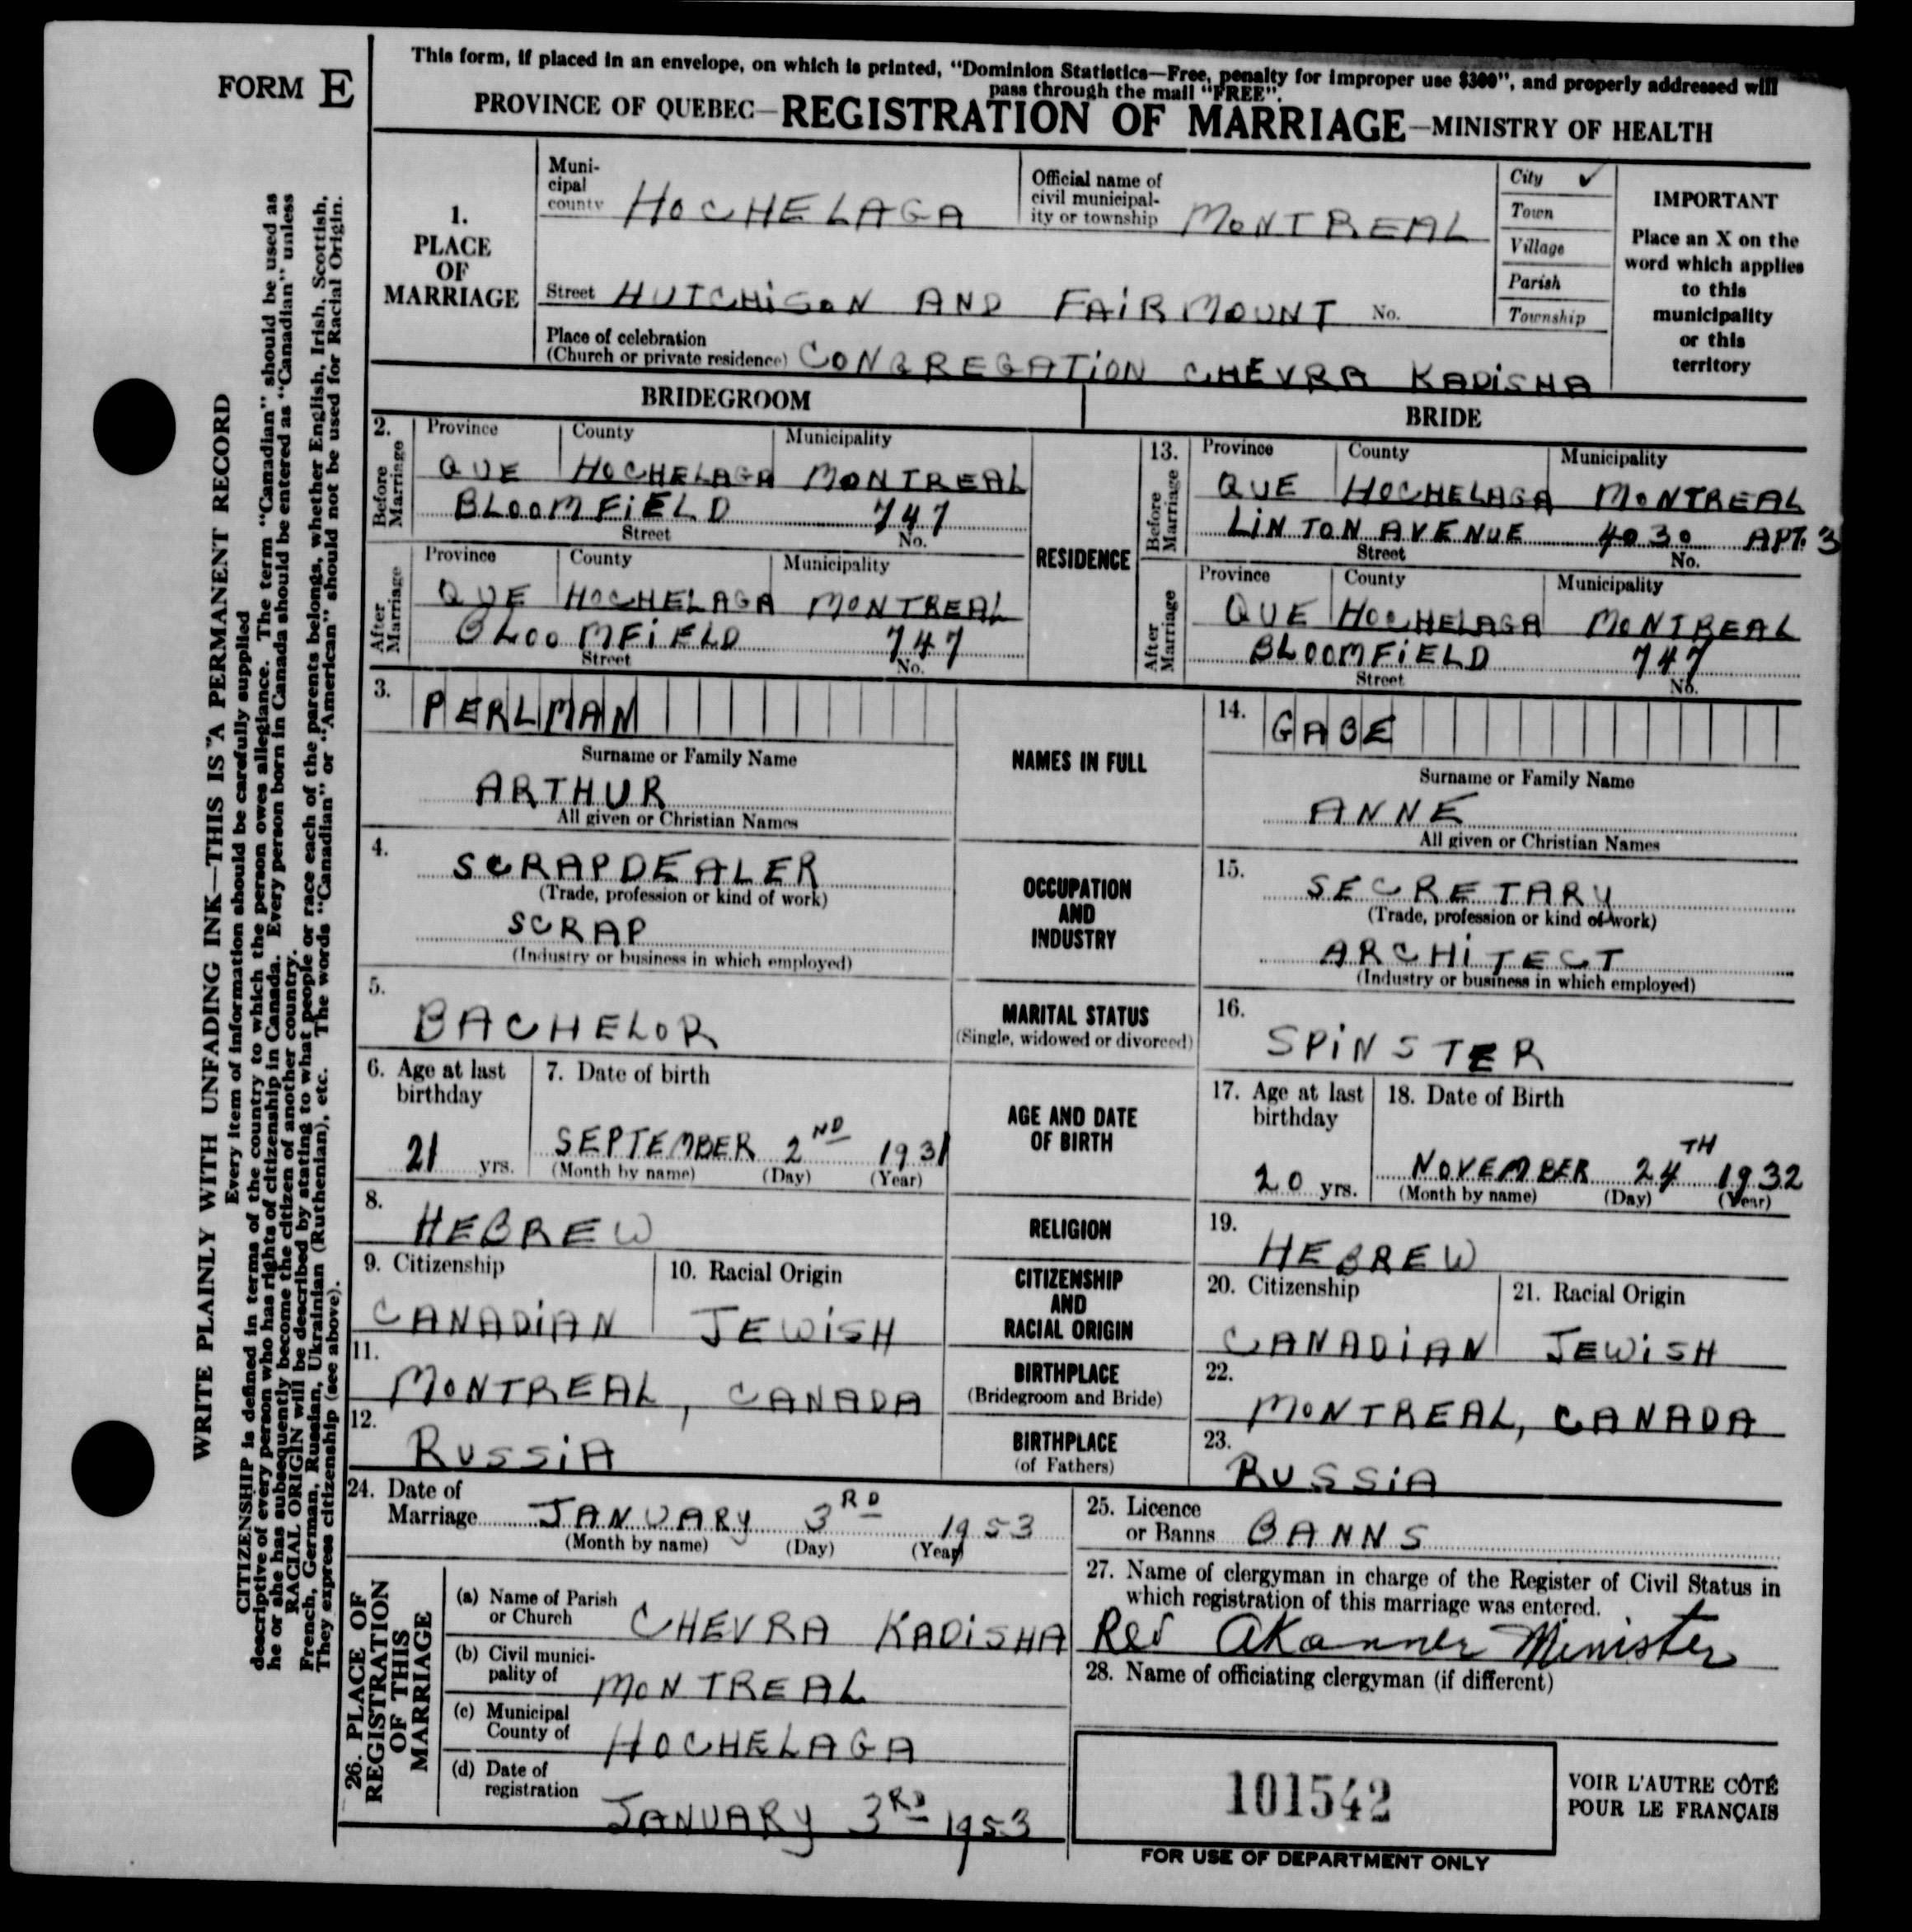
Research: 1953 Registration
Maiden name (Gabe)
Birth (Montreal)
Fathers’ birthplaces
Different years = different information
Notes:
Different years records differ (e.g., parents)

Slide 7
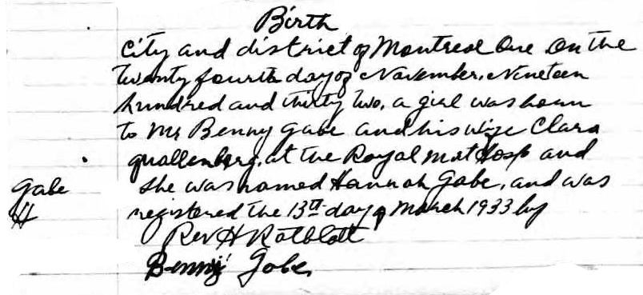
Research: “1933” Shul Birth Record
No match for Anne Gabe
Search for Gabe birth in 1932, find H. Gabe in 1933

Slide 8
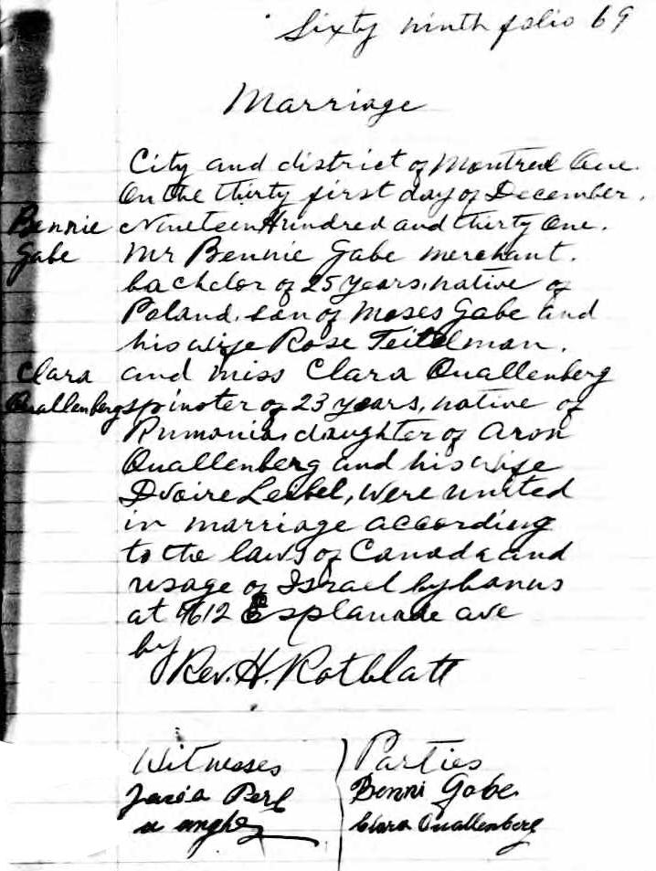
Research: Shul Marriage Record
Mini-family tree
Birthplaces, ages
Signatures

Slide 9
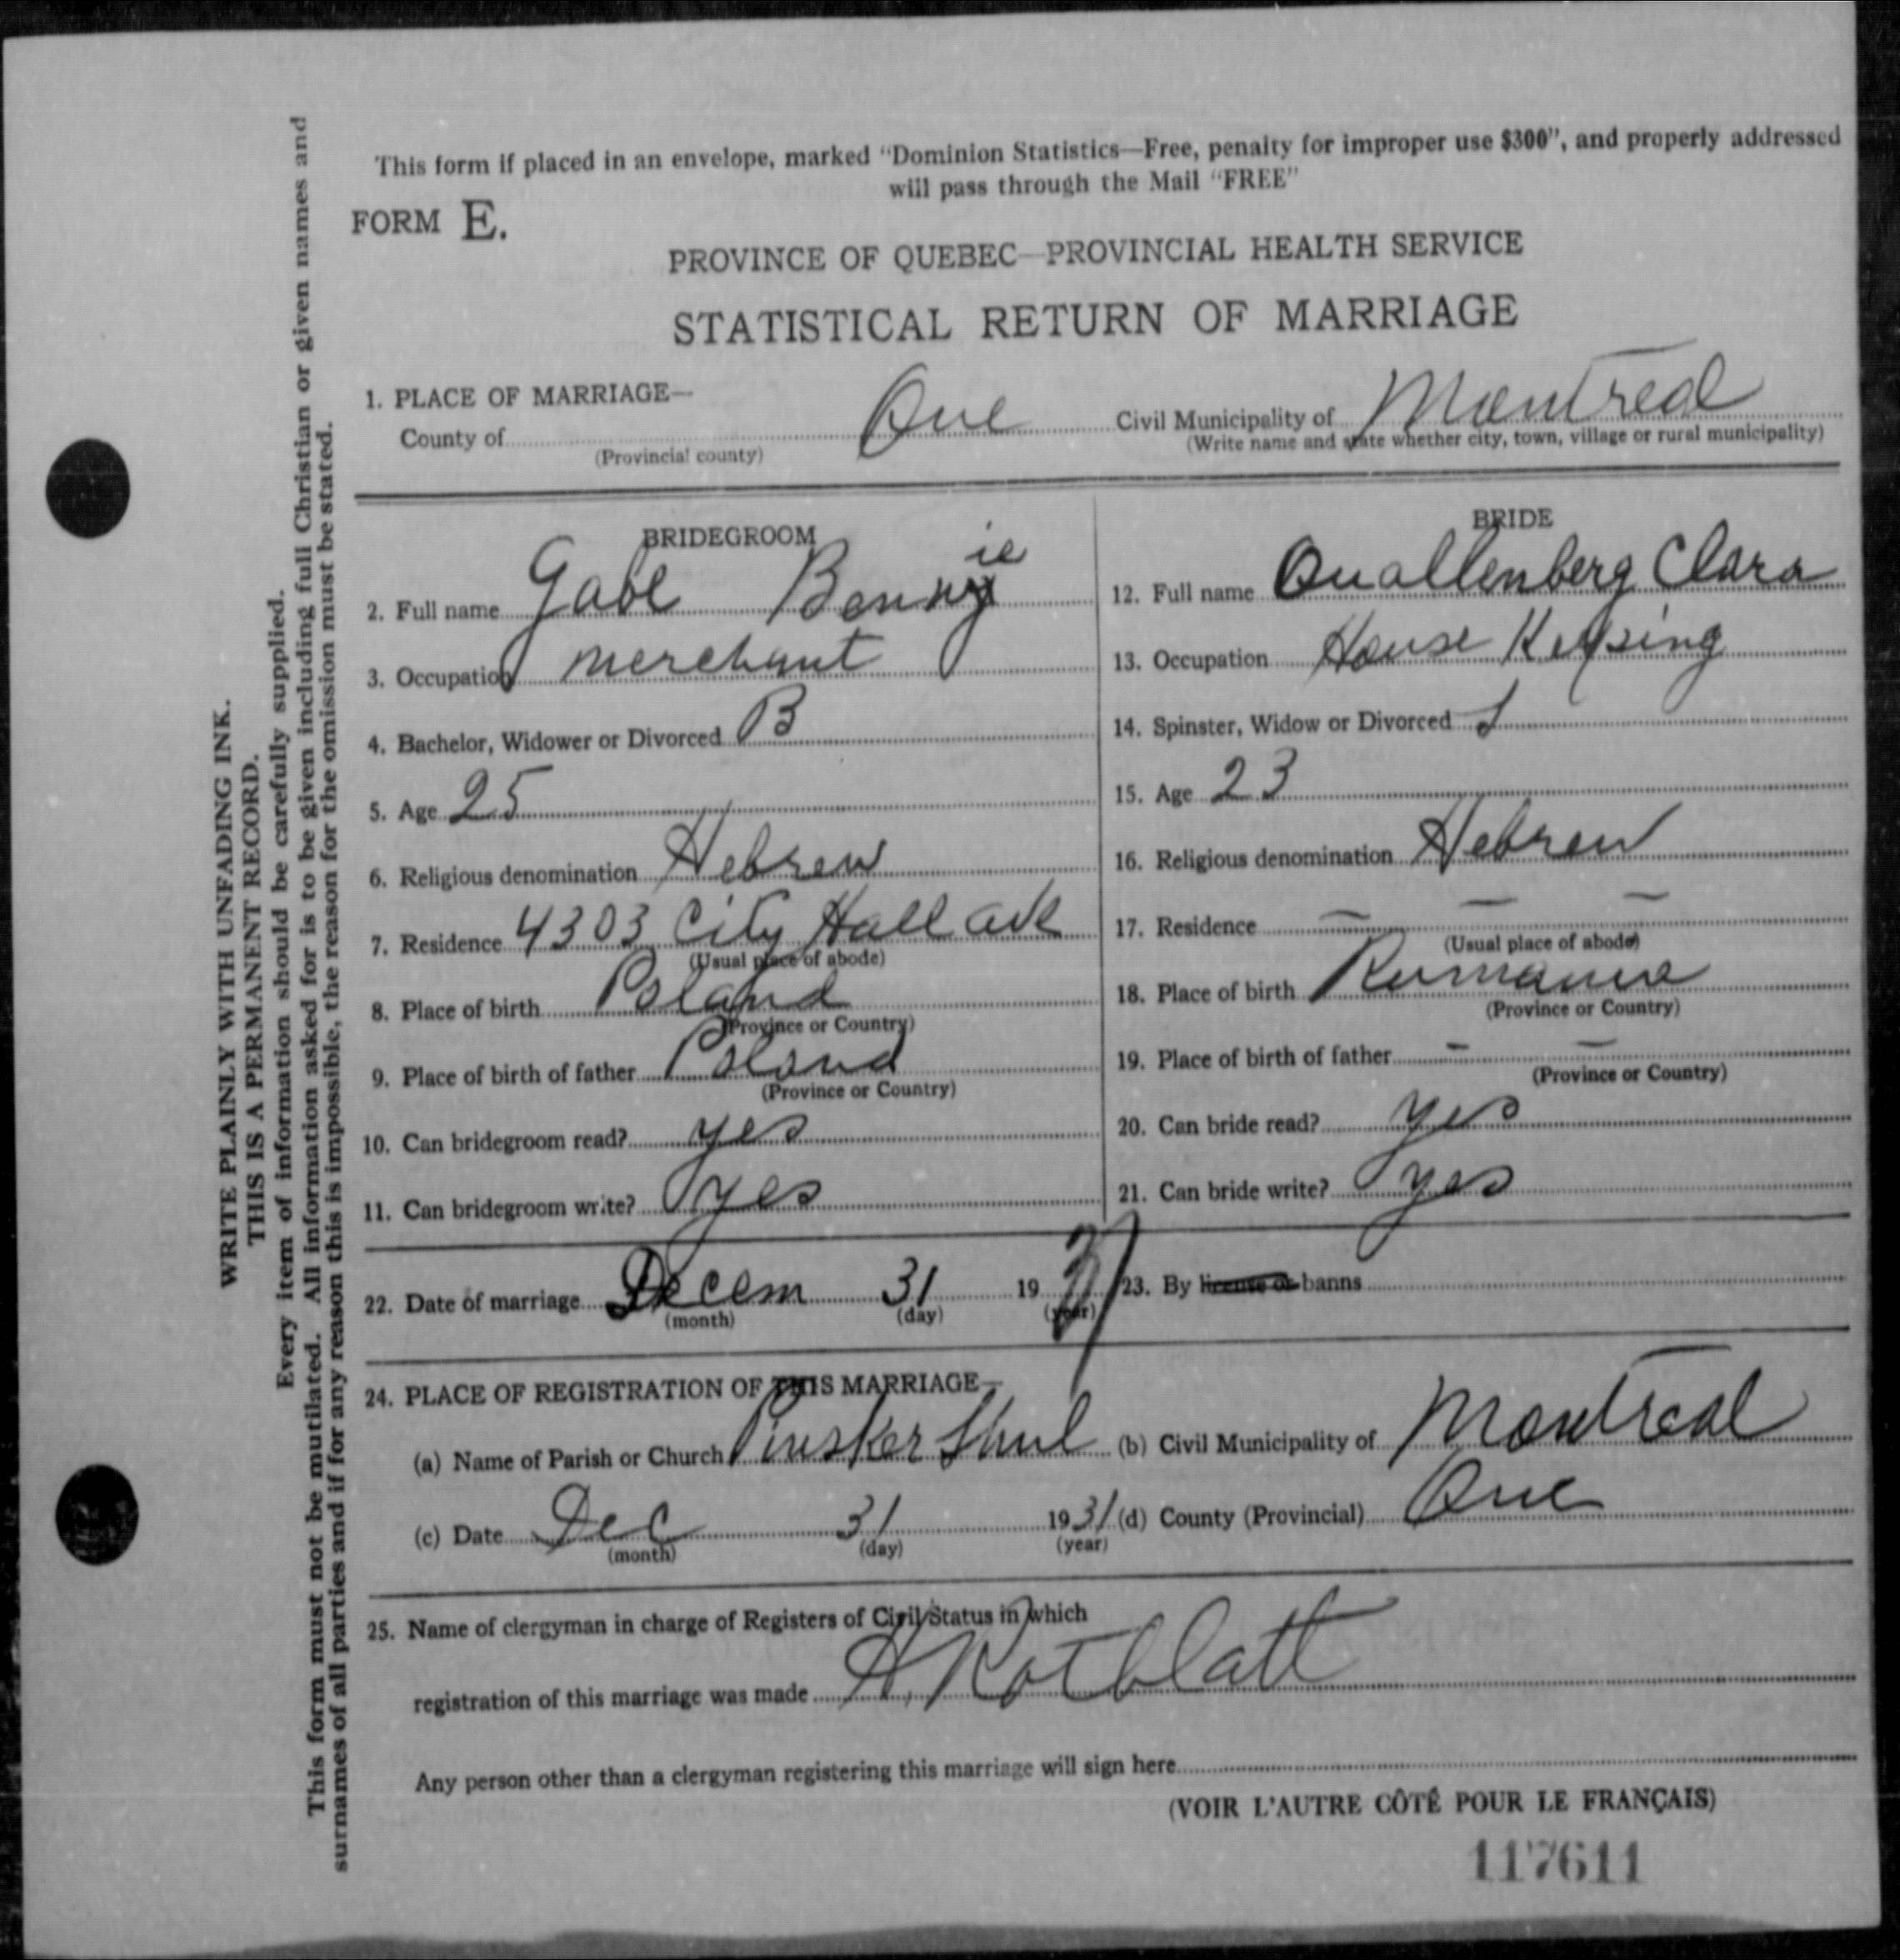
Research: Civil Marriage Record
Marriages 1926-1997
Birth places, age

Slide 10
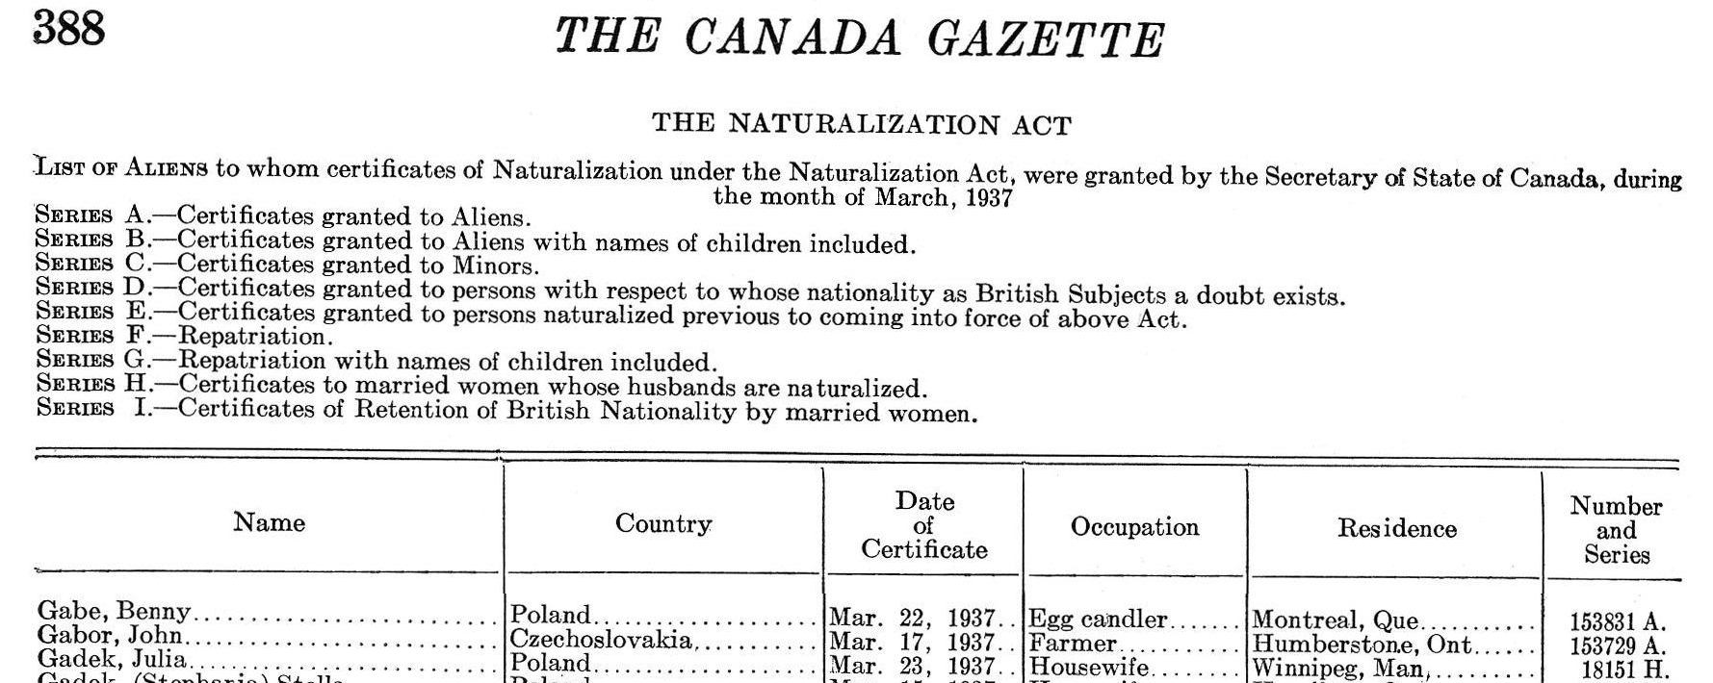
Research: Naturalization Index
Notes:
Benny, Benni, or Bennie?
Use Ben +wildcard character
MCC or Federal? One click for each

Slide 11
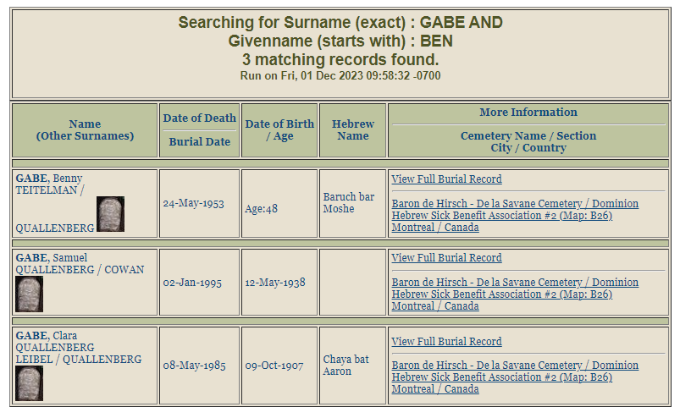
Research: Naturalization Support
Need proof of death beyond 20 years
May need for spouse
Notes:
Inexpensive to request
Many questions to answer – use guide

Slide 12
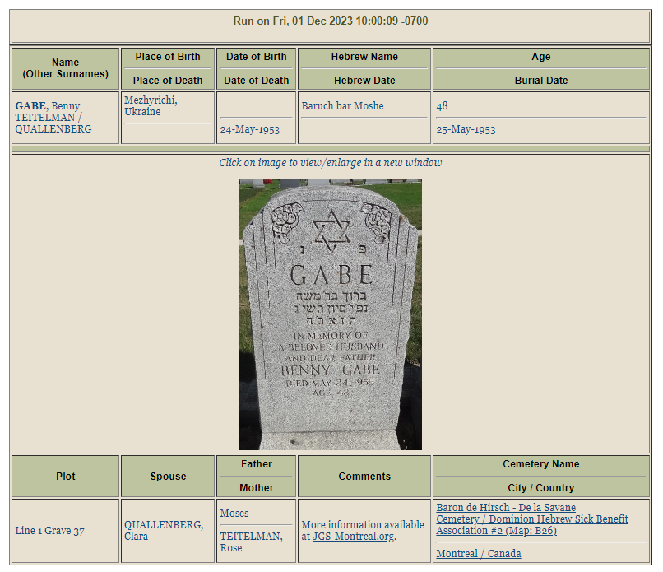
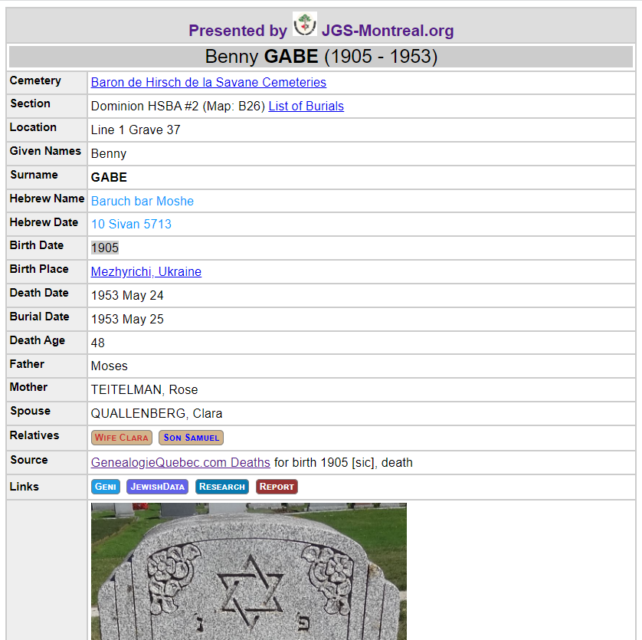
Research: Naturalization Support
Notes:
Can also use obituaries
Often, names don’t exactly match, so explain

Slide 13
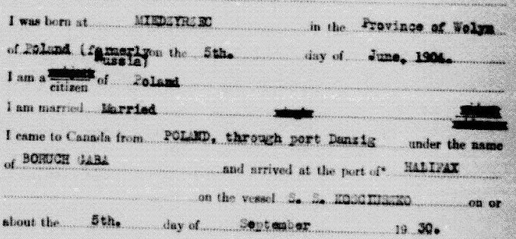
Research: Naturalization Application
Inexpensive request
Shows aliases – Boruch GABA
Birth Miedzyrsec, Wolyn, Poland
RCMP report
Notes:
Full PDF: https://jowbr.org/gen/1937-benny-gabe-naturalization-file.pdf
Immigration page shows destination:
Bejla Appel, Winnipeg

Slide 14
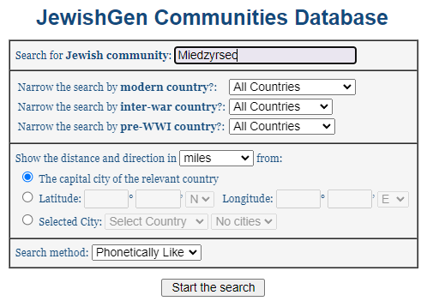
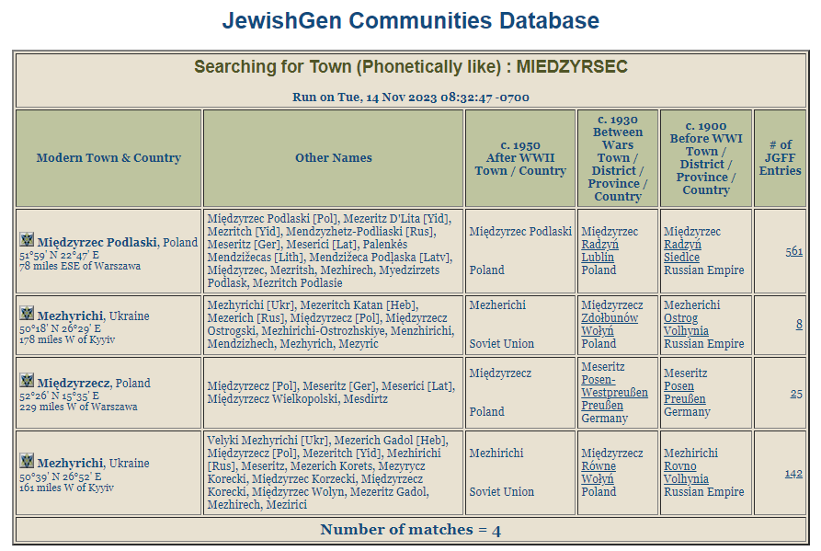
Research: JewishGen Town Finder
Notes:
Many search options for Town Finder
Pay attention to provnce name (Wolyn)
JGFF Family Finder may connect you to relatives

Slide 15
Research: Next Steps
Other Gabe / Quallenberg
1940 National reg.
Immigration
Burial data

Slide 16
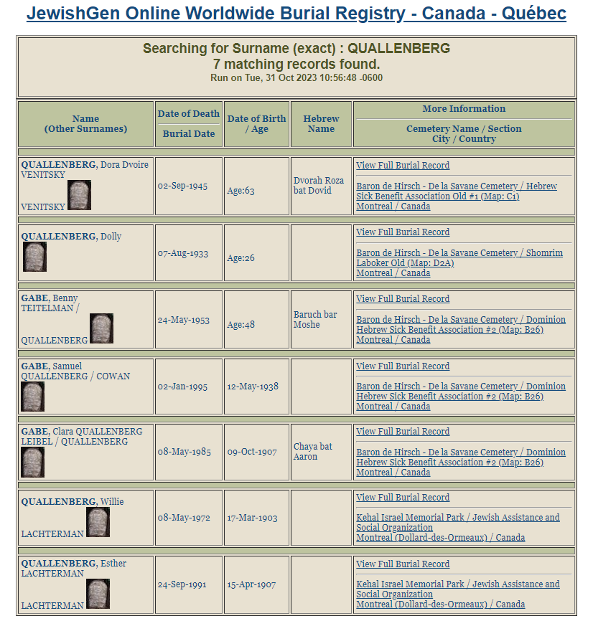
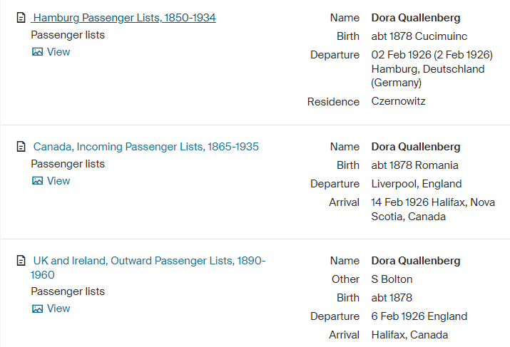
Research: Next Steps

Slide 17
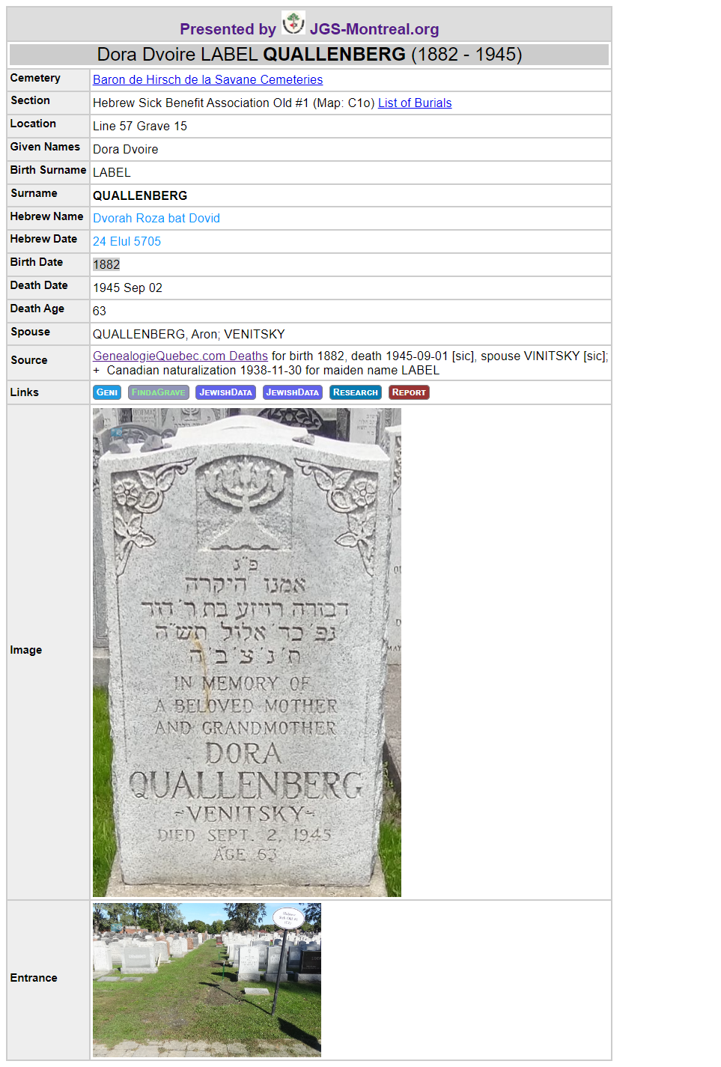
Research: Next Steps
JGS-Montreal details
Hebrew name/date
Sources
Links

Slide 18
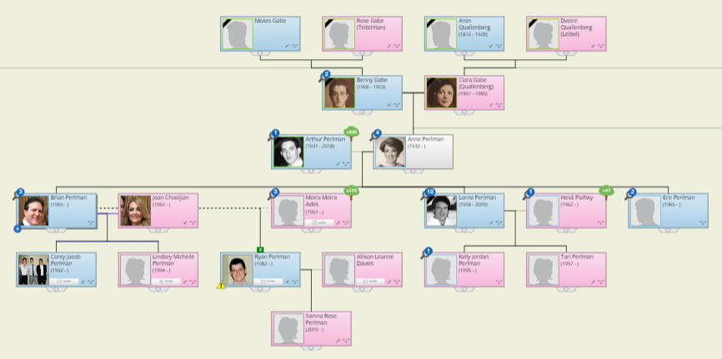
Organizing Information in Trees
Helps represent complexity
Add documents, photos
Many sources
Notes:
Geni.com is online and shared
Ancestry.ca has the best search + excellent integration of document
MyHeritage.com and FamilySearch.org
Geni.com is owned by MyHeritage.com
Geni is free and easy to use, so it's widely used
Family Tree Maker keeps data private and safe on your machine
I keep my tree on several platforms
9/10 matches with "strangers" come from Geni - which is indexed by Google
some researchers "dislike" Geni because of sharing
I found my client 3x in Geni tree, 1x as her own mother
After repair, had a tree with over 1200 people
Anne's profile is private, so you won't see much

Slide 19
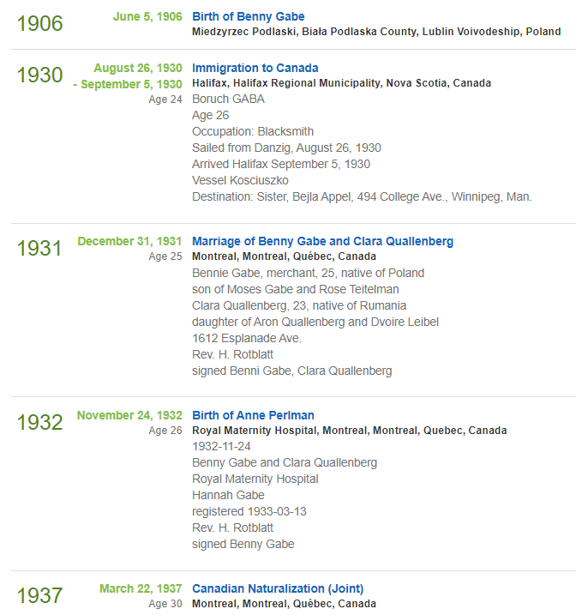
Organizing: Timelines
List of events
Events can have documents, pictures

Slide 20
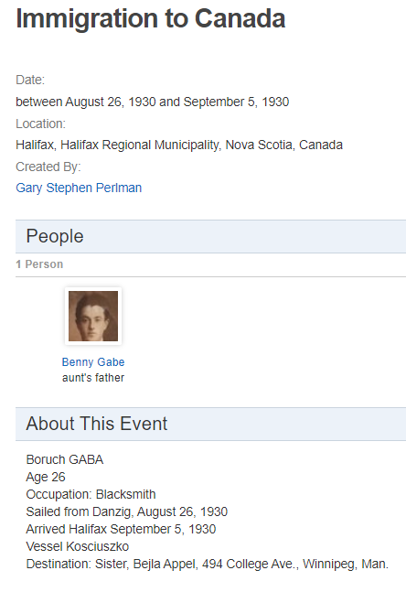
Organizing: Events
Events involve people
Events have documents

Slide 21
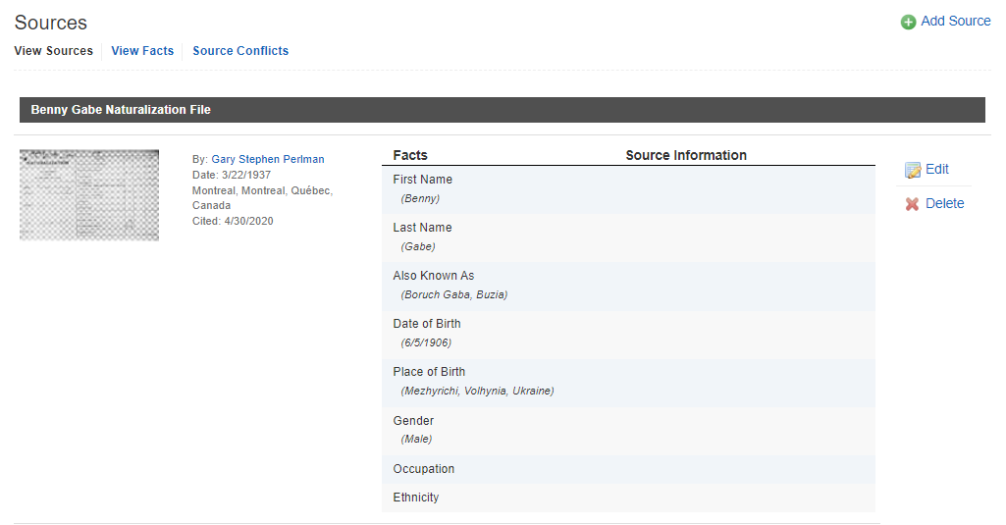
Organizing: Sources
Sources provide evidence for facts
Documents can be used as sources

Slide 22
Where to Learn More
JGS-Montreal.org
Genealogy Dashboard
JewishGen.org
Family Finder
Town Finder
View-Mate
Burials
SIGs
JRI-Poland.org
Using search services
Flexible spelling
Combinations of terms
Learn search syntax
Notes:
Spelling variations, errors in data
Search syntax varies:
- substring, wildcards, soundex (variations)
- some search services have soundex built in
- if you aren't sure, you can experiment
- Don’t assume

